Slide 1
ElasticSearch Powered Machine Learning
Nicholas Papano

Slide 2
ElasticSearch
Designed by Amazon
Open-Sourced
REST-based querying (just like GraphQL)
Sharding
Replication
Inverse Index
Amazon OpenSearch

Slide 3
ELK Stack – for all your at-scale Needs
ElasticSearch
Searching
LogStash
Logging
Metrics
Kibana
Analysis
Machine Learning
Visualization

Slide 4
The data
Kickstarter descriptions (https://www.kaggle.com/oscarvilla/kickstarter-nlp)
Classified into successful and failed projects
215513 rows
108310 Successful
107203 Failed
Only loaded ~45k for the point of the demo

Slide 5
NLP Basics – Term Frequency
“How often does the word appear in this document?”
Repetition
Locality
Example: Relativity mentioned by Albert Einstein

Slide 6
NLP Basics – Document Frequency
Occurrence of the word across documents
“How many unique documents does this word appear in?”
Inverse document frequency = 1 / document frequency

Slide 7
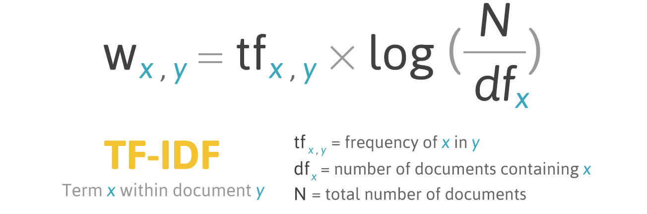
Putting it together – TF-IDF
Similar to how ElasticSearch works

Slide 8
What does a high TF-IDF Value mean?
Increases value: The word appears a lot in a single document
Increases value: The word does not appear in very many documents
Decreases value: The word appears very little
Decreases value: The word appears in a lot of documents
Highest TF-IDF values: Words that don’t appear in a lot of documents, but when they do, they appear a lot

Slide 9
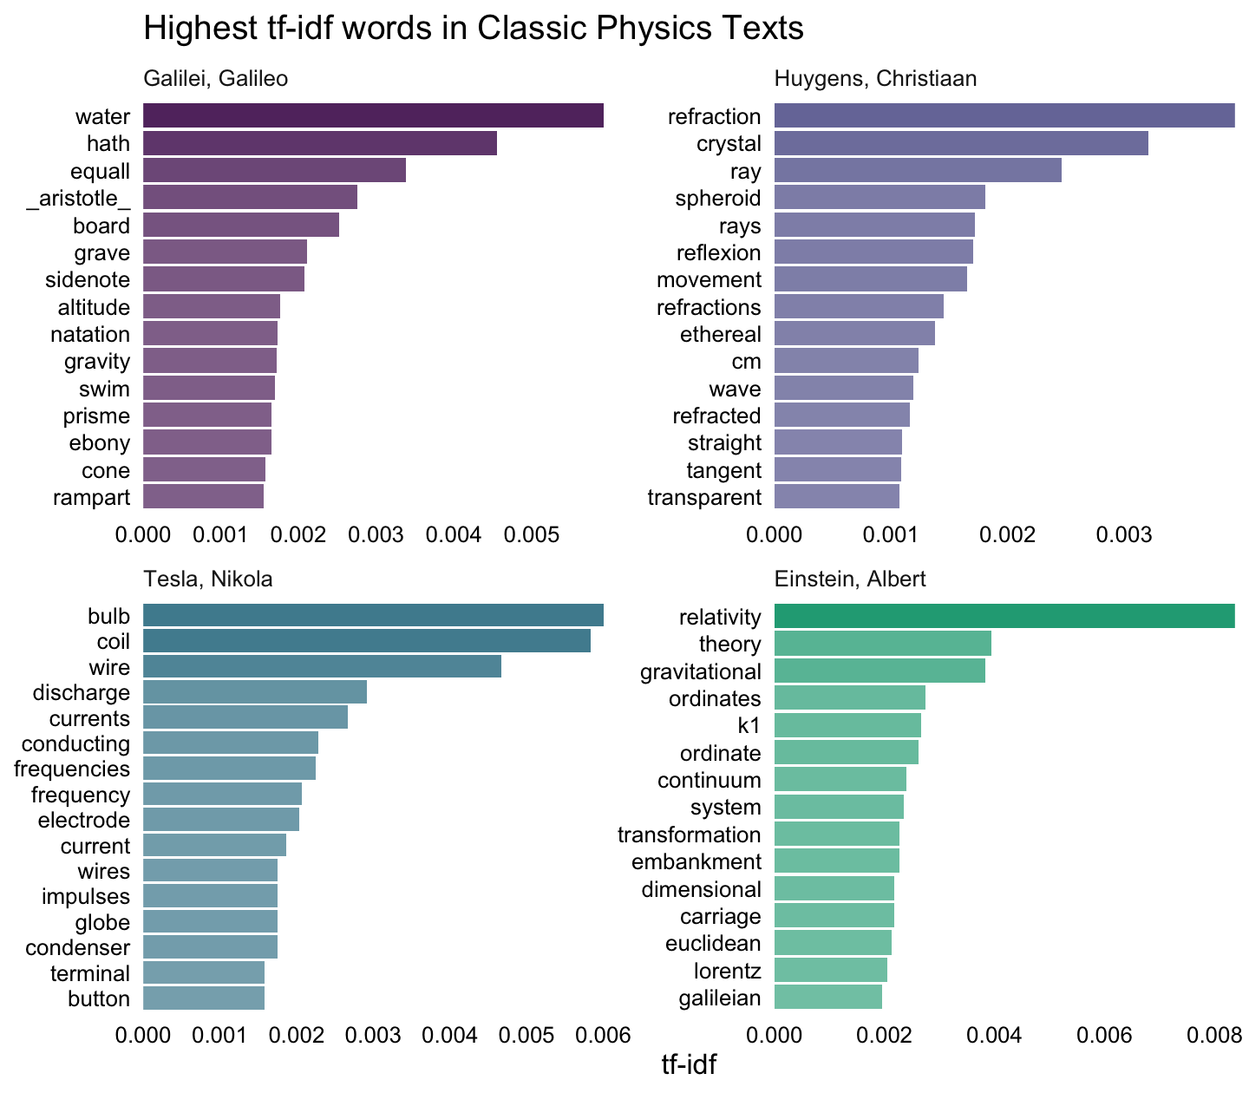
Example – TF-IDF
Physics Texts
Supercalifragilisticexpialidocious

Slide 10
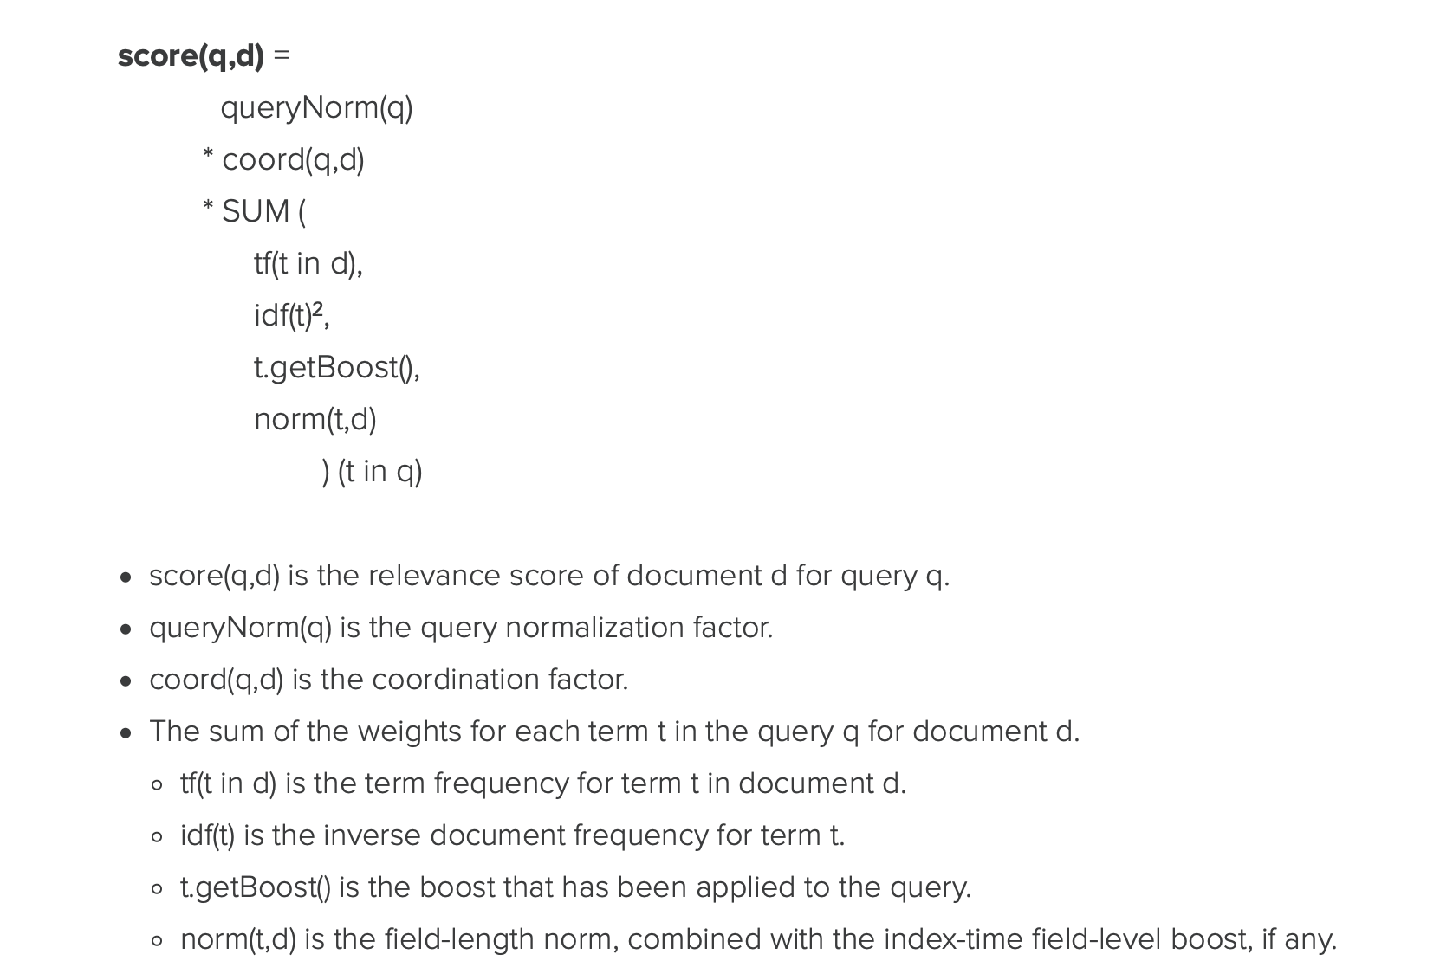
Scoring in Elasticsearch
Query normalization factor
Hyperparameter
Coordination Factor
Hyperparameter
Sum of values
TF
IDF (squared)
Boost
Field-length normalization

Slide 11
Demo – How ElasticSearch Scores

Slide 12
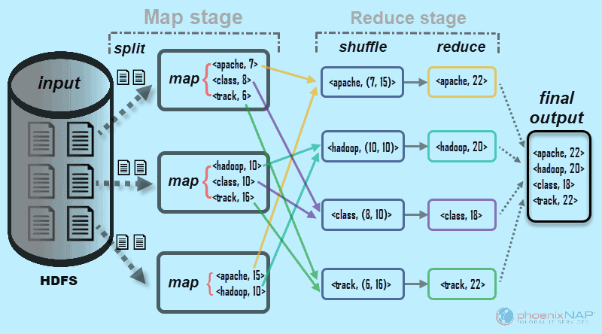
The magic of Map-Reduce
Parallelizes extremely well
Inverted index is part of this
Operations
Split
Map
Shuffle
Reduce

Slide 13
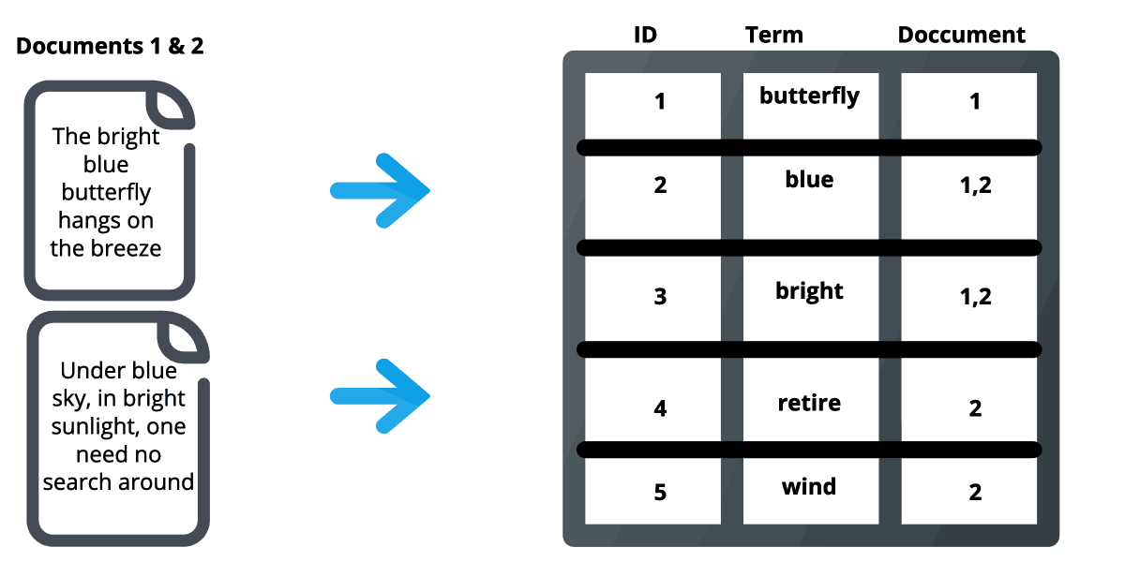
Inverted Index

Slide 14
What is ElasticSearch Doing during a query?
Ex. (Blue) or (Retire)
Get from term list
Grab list of documents
Get each document by id
Score relevance
Return results

Slide 15
Q: “These values are cool and all, but What do we Do With them?”

Slide 16
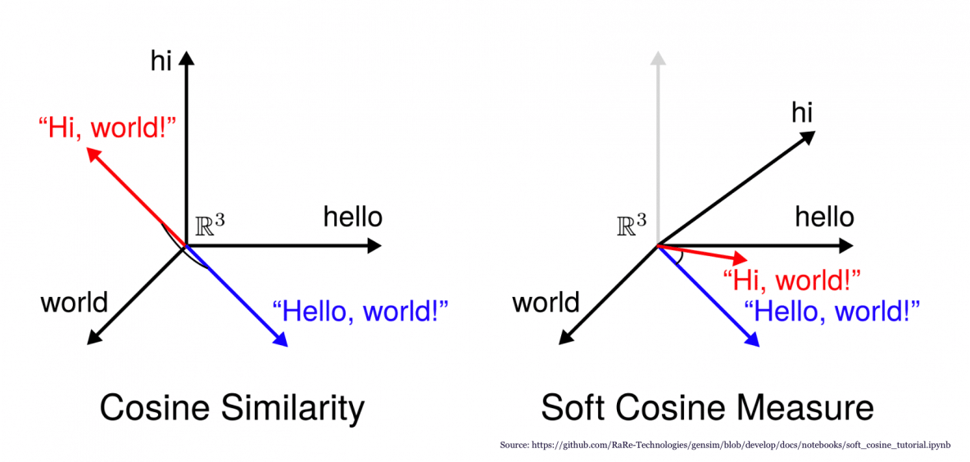
Defining “Relevance”
In search, what makes one result better than another?
Google PageRank
Trie data structure
TF-IDF
Cosine Similarity

Slide 17
Q: “So, given a new Search, how do we do machine learning on it?”

Slide 18
Quick Aside – Data Cleaning
def remove_non_alphanumeric(text): return re.sub("[^a-zA-Z]", " ", text) def convert_to_lowercase(text): return str(text).lower() def tokenize(text): return word_tokenize(text) def remove_stopwords(text): return [item for item in text if item not in set(stopwords.words("english"))]
Important to do
Bad data = bad model
Some examples for cleaning
Lowercase
Remove stopwords
Alphanumeric only

Slide 19
Kickstarter Data – Columns
Column 1: Short description of the project
Ex. “A new marketplace for personalized 1-to-1 streaming video – from live smartphone feeds to drone and VR / 360° daredevil experiences.”
Notice how this isn’t cleaned
Column 2: Was the project successful? => {Successful, Failed}

Slide 20
Building Intuition – Brainstorming
What is a Kickstarter?
What do they need the money for? (Development? Delivery? Assembling/Coding?)
What are they trying to create? Scam?
What makes a Kickstarter good? Successful traits?
What makes a Kickstarter bad? Bad omens?

Slide 21
Setting It up
Supervised?
Unsupervised?
Clustering
K-Means

Slide 22
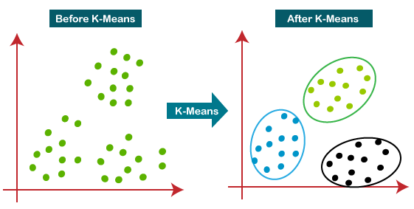
Something to investigate: K means Clustering
Not what we will be doing
Clusters data
Unsupervised
Provide a K value
Groups data K groups

Slide 23
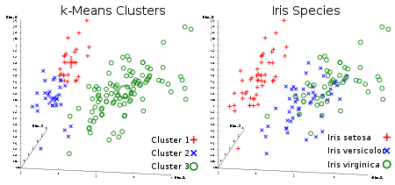
Finalizing Intuition
What makes something part of a group?
Fixed radius circle?
Closest points
Distance metrics?
K nearest neighbors

Slide 24
Can ML always GET THE right answer?

Slide 25
Putting it all together
Data: group of already classified Kickstarter Projects
Goal: Given a new Kickstarter description, can we predict if the project will be successful or not using our dataset?
K-Nearest Neighbors – k is a hyperparameter we can tune for
Distance metric: Elasticsearch score
Intuition: The new description belongs to the same class as its’ nearest neighbors

Slide 26
Demo - Supervised Learning of Kickstarter data

Slide 27
Questions?

